Slide 1

1
목차
Seq2Seq Model
Attention, Self-Attention, Graph-Attention
Attention Network in Deep Reinforcement Learning

Slide 2
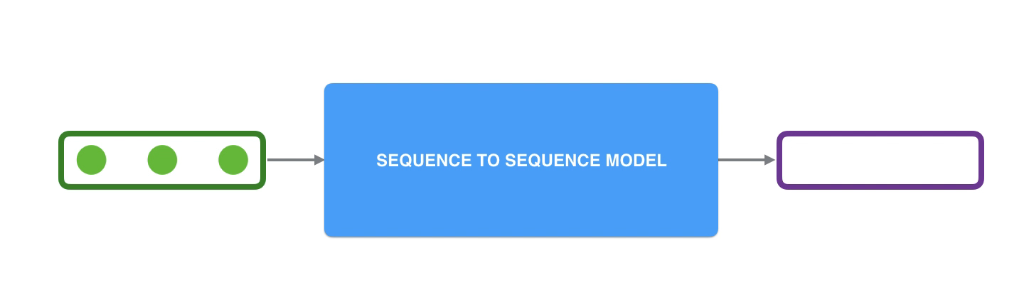
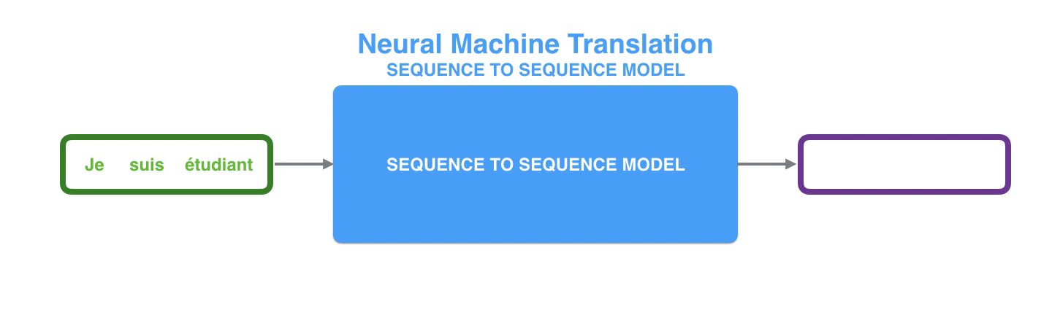
1
SEQ2SEQ MODEL

Slide 3
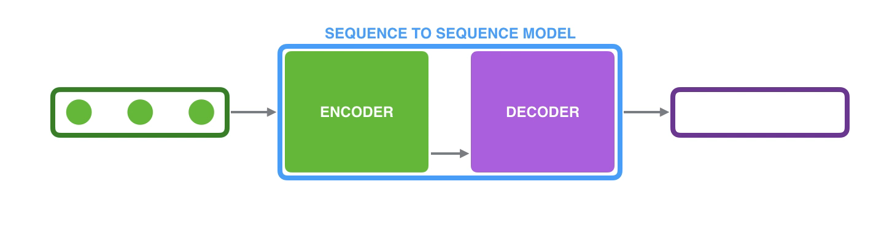
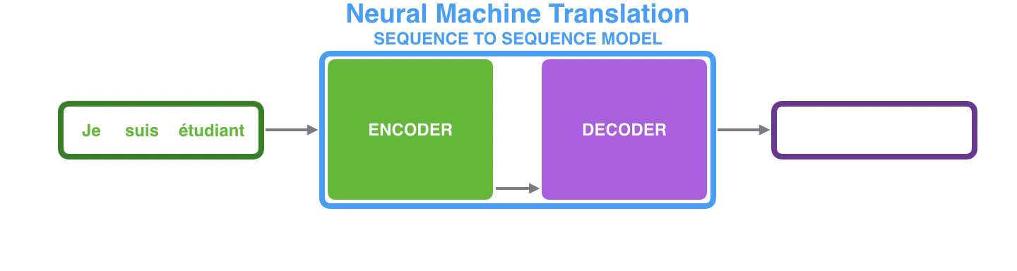
1
SEQ2SEQ MODEL

Slide 4
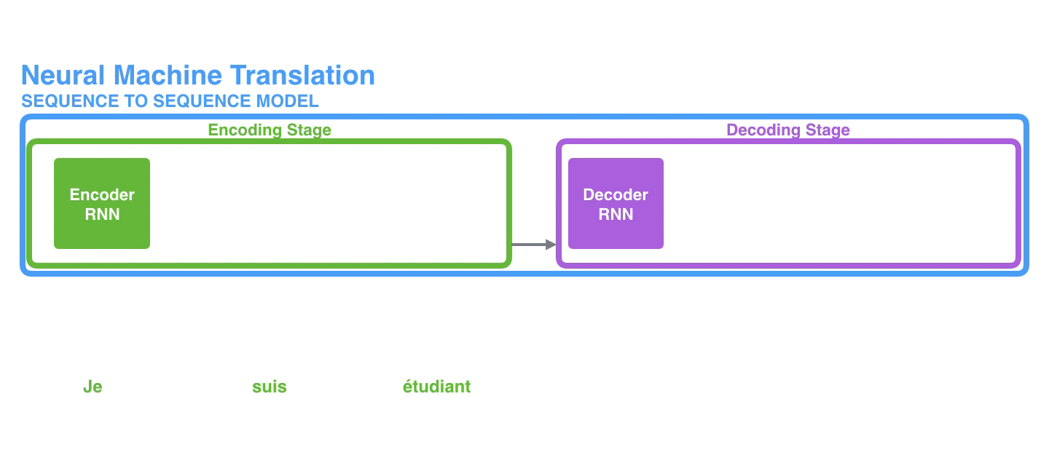
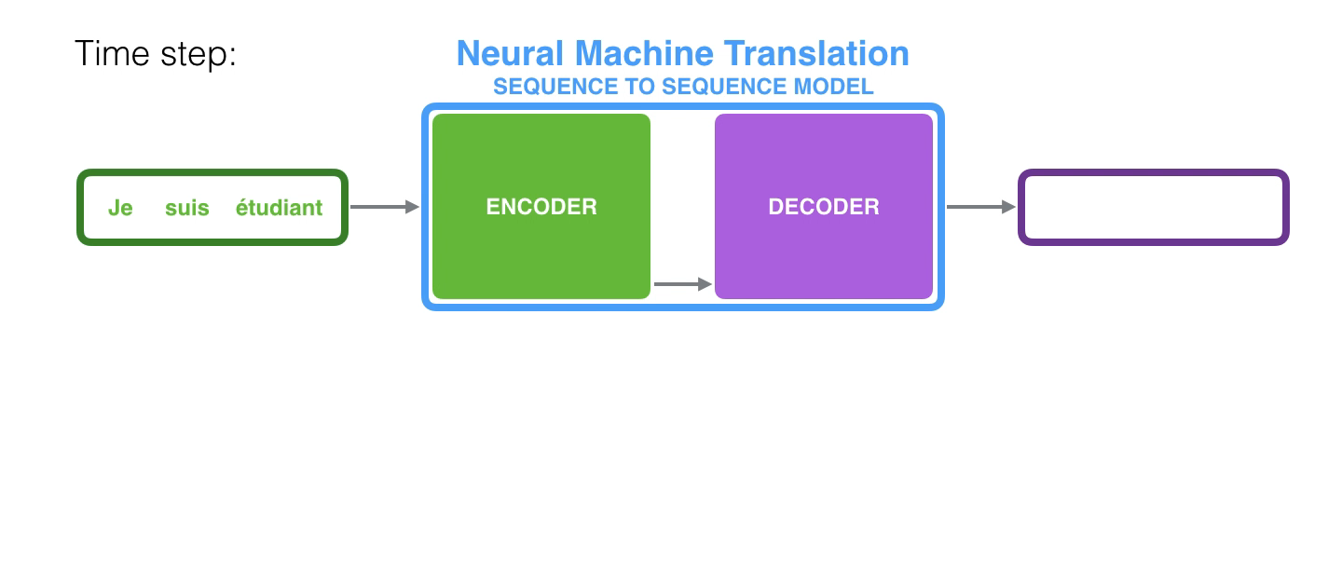
1
SEQ2SEQ MODEL

Slide 5
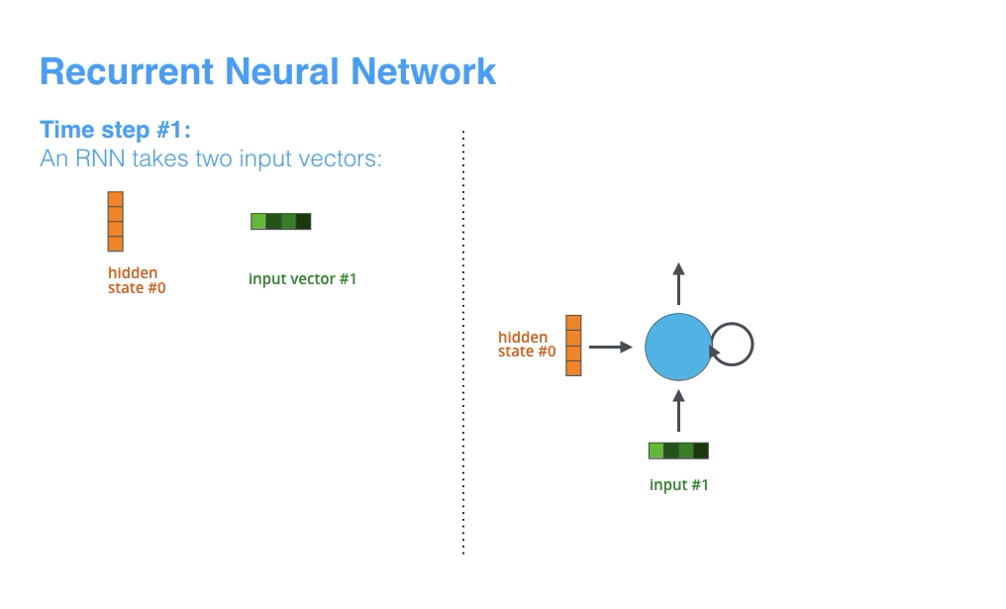
1
SEQ2SEQ MODEL

Slide 6
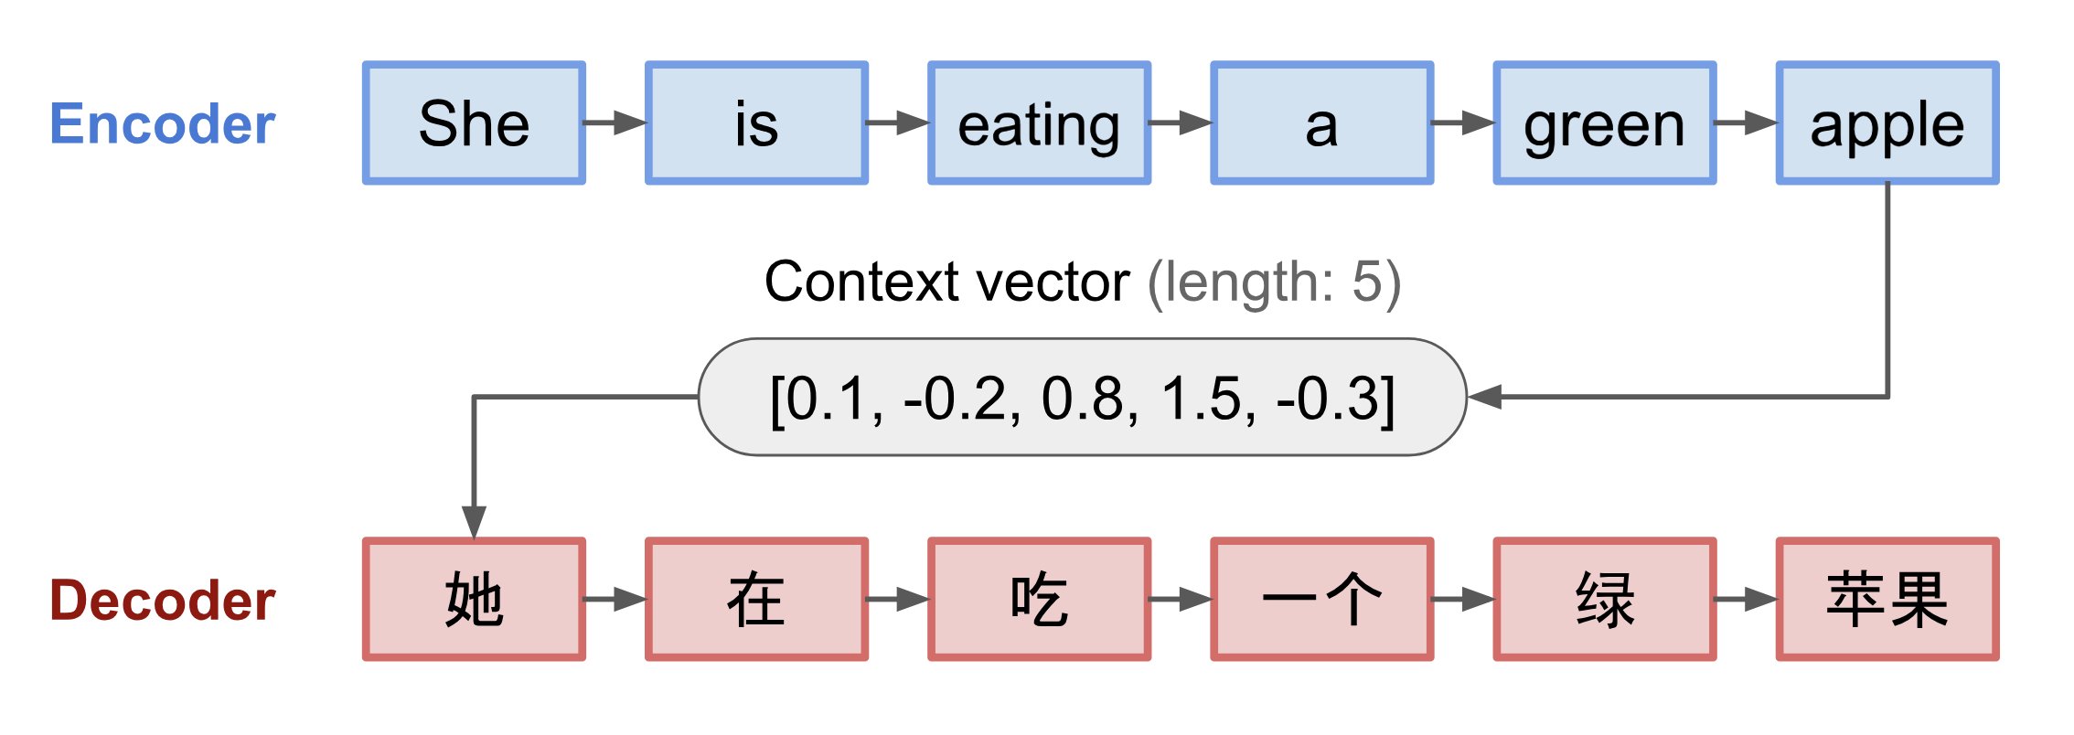
1
ATTENTION
Attention : the attention vector how strongly it is correlated with other elements

Slide 7
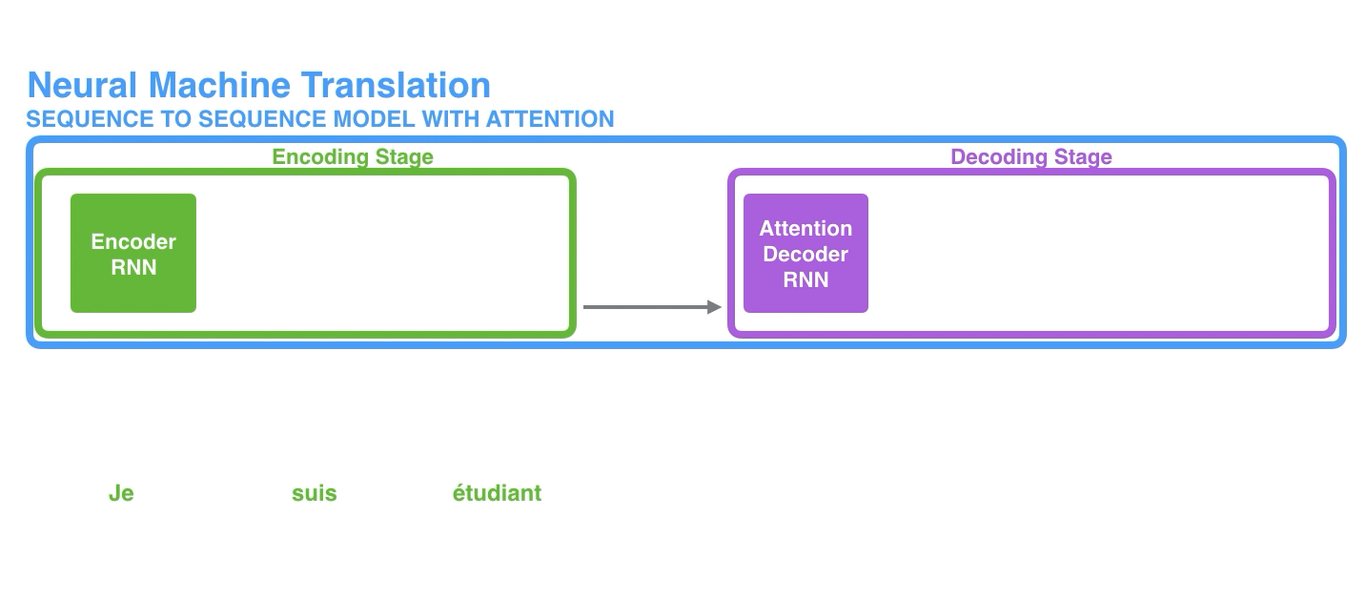
1
ATTENTION

Slide 8
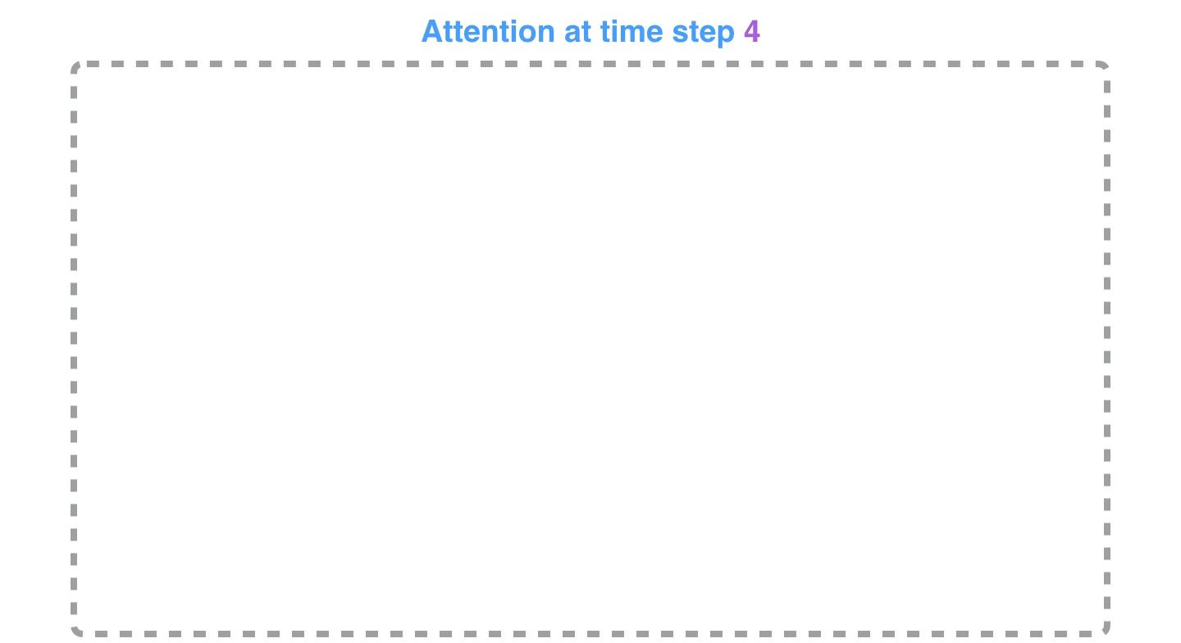
1
ATTENTION

Slide 9
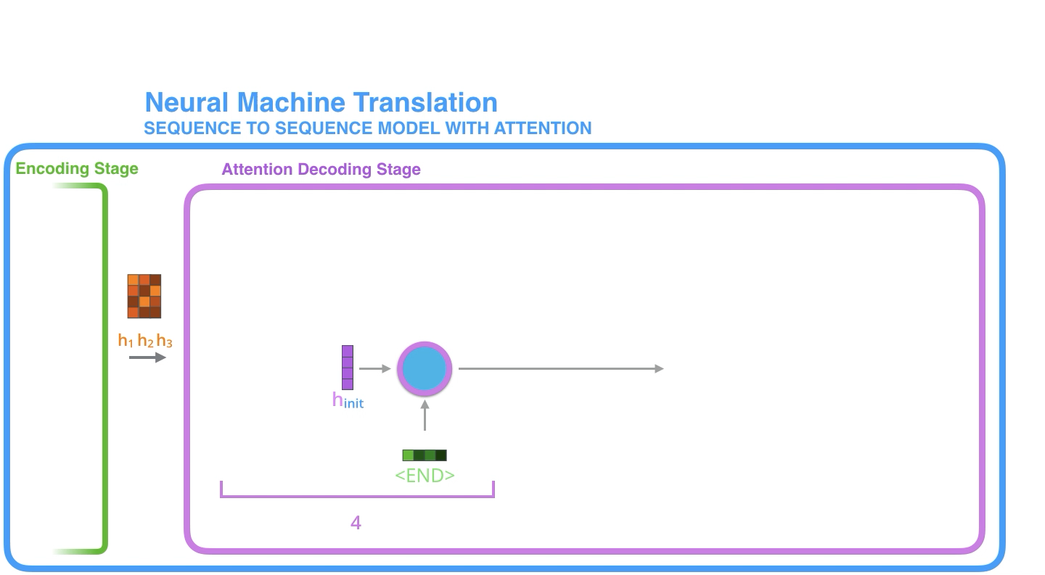
1
ATTENTION 장점
The dependencies between source and target sequences are not restricted by the in-between distance anymore!

Slide 10
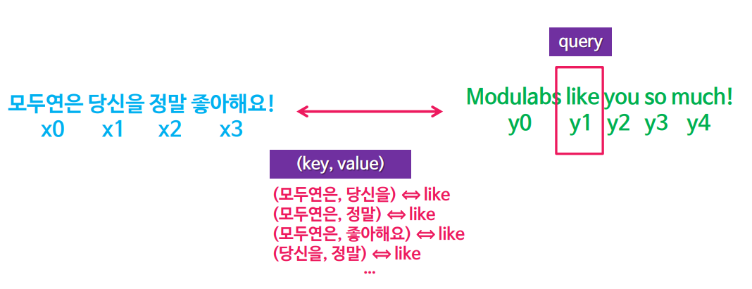
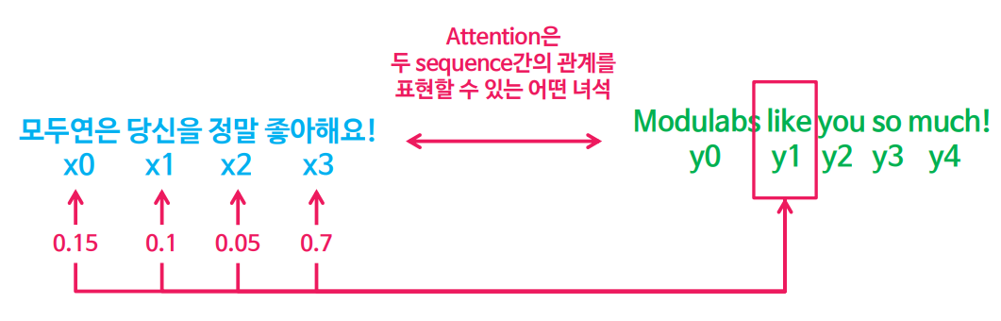
1
ATTENTION and SELF-ATTENTION
Attention
Self-Attention
한 단어와 한 단어 간의 관계
Query와 (Key, Value)간의 관계

Slide 11
1
SELF-ATTENTION
(Modulab, like) ⬄ 좋아해요!
(Modulab, so much) ⬄ 좋아해요!
(Modulab, you) ⬄ 좋아해요!
(you, so much) ⬄ 좋아해요!
가장 잘 번역 될 수 있는 (key, value) pair
Query 제일 잘 표현할 수 있는 (key, value) pair

Slide 12
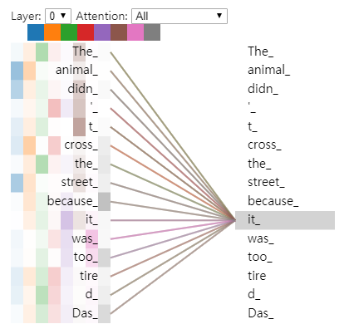
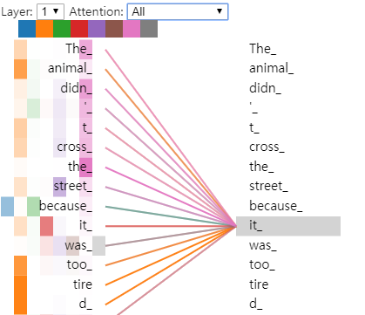
1
SELF-ATTENTION
“The animal didn't cross the street because it was too tired”
자기 주의를 기울여 입력 시퀀스의 다른 위치에서 단서를 찾아 볼 수 있으므로 단어를 더 잘 인코딩 할 수 있다.

Slide 13

1
SELF-ATTENTION
Input : Query, Key, and Value Vector
Q, K, V (64) < Embedding Vector (512)

Slide 14
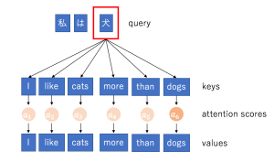
1
SELF-ATTENTION
English → Chinese
Values : the relevance of the encoder hidden states
Query : the decoder state
Keys : the encoder hidden state

Slide 15
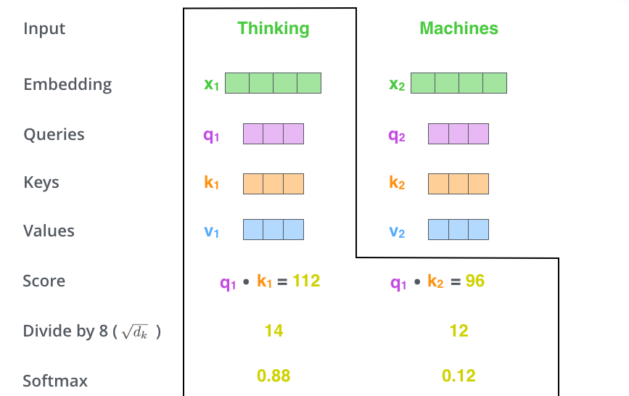
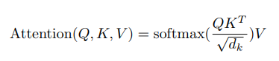
1
SELF-ATTENTION
Score : 특정 위치에 단어를 인코딩 할 때 입력된 문장의 다른 부분에 얼마나 많은 초점을 둘지 결정
Divided by number : Stable gradients
Softmax score : 각 단어가 각 포지션에서 얼마나 표현 될지

Slide 16
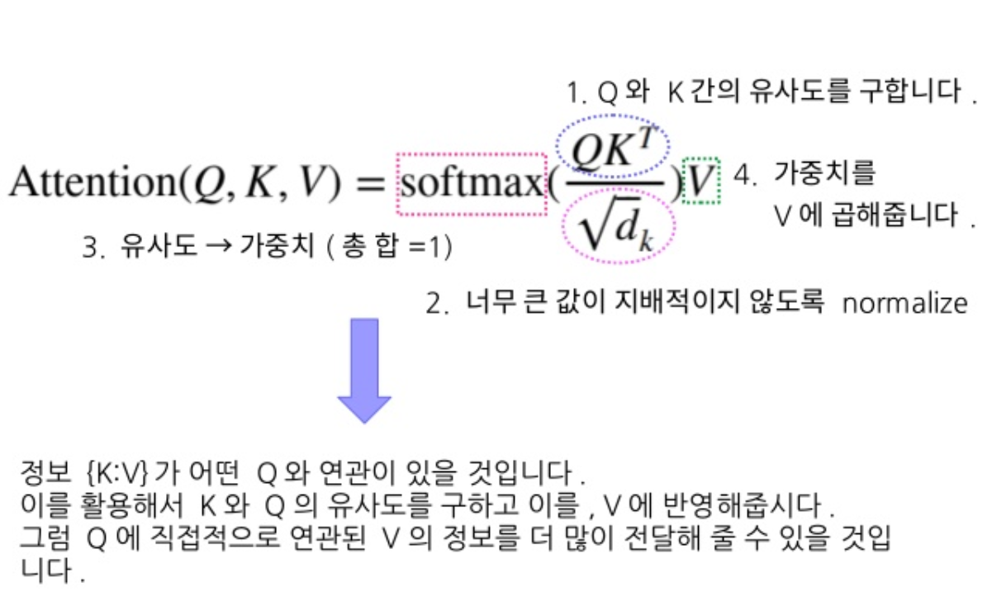
1
SELF-ATTENTION

Slide 17


1
SELF-ATTENTION

Slide 18
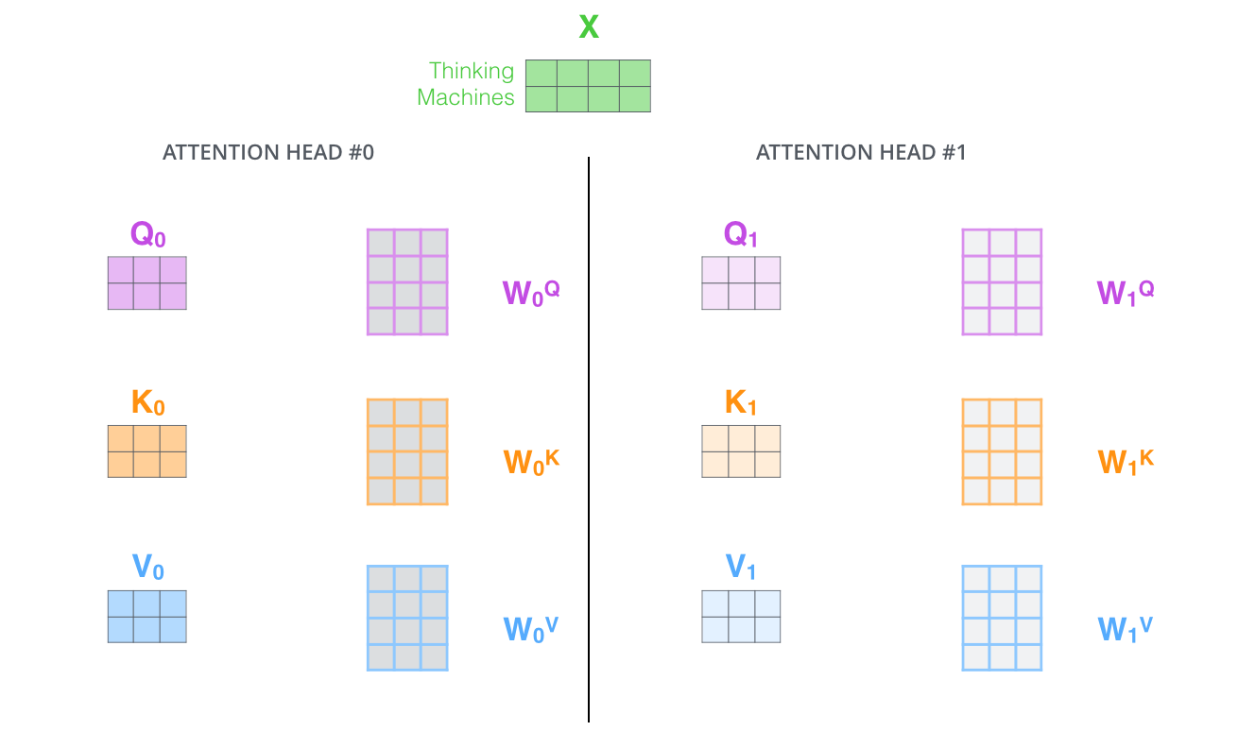
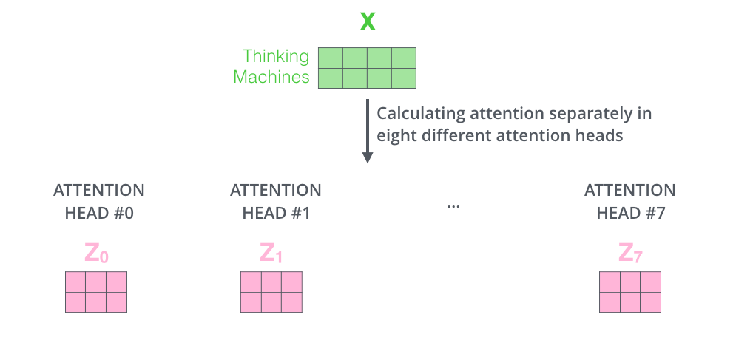
1
SELF-ATTENTION

Slide 19
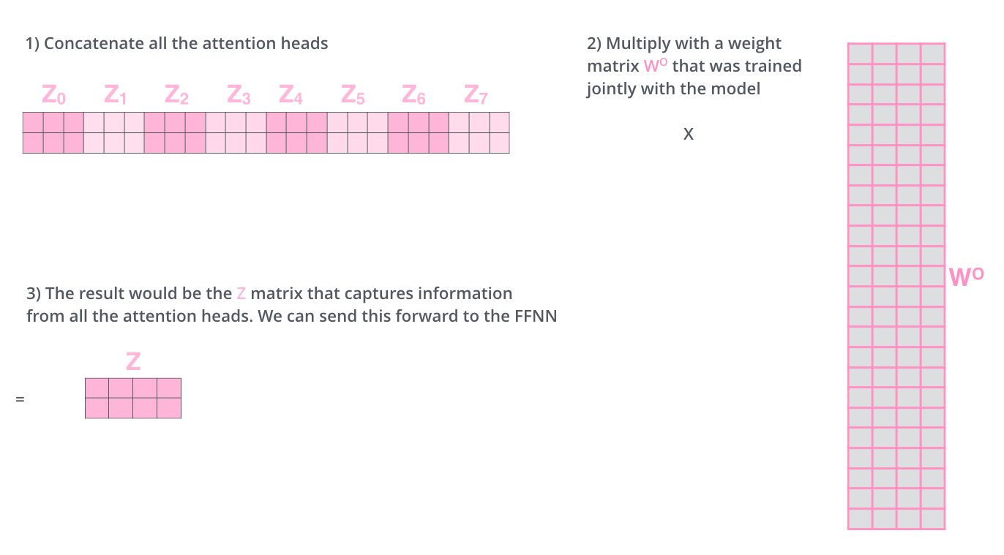

1
SELF-ATTENTION

Slide 20
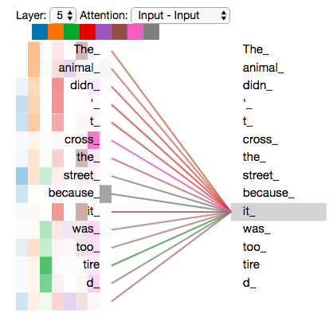
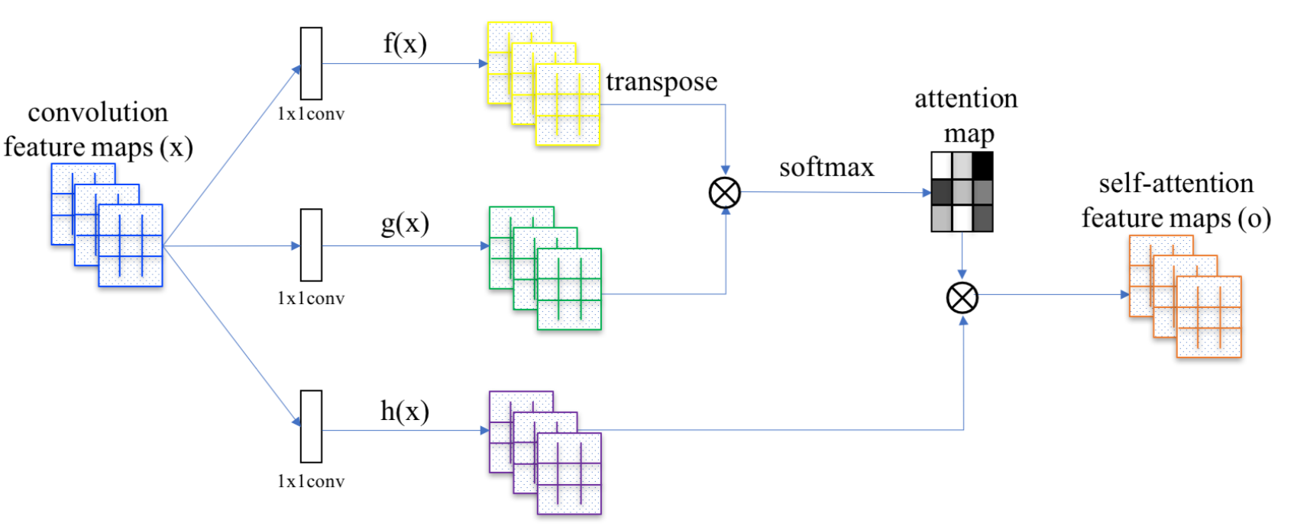
1
SELF-ATTENTION VISUALIZATION and CNN

Slide 21
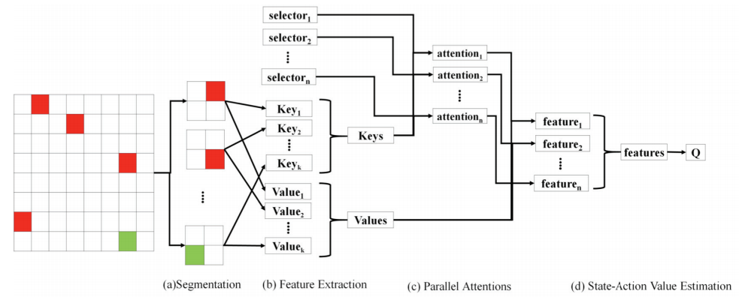
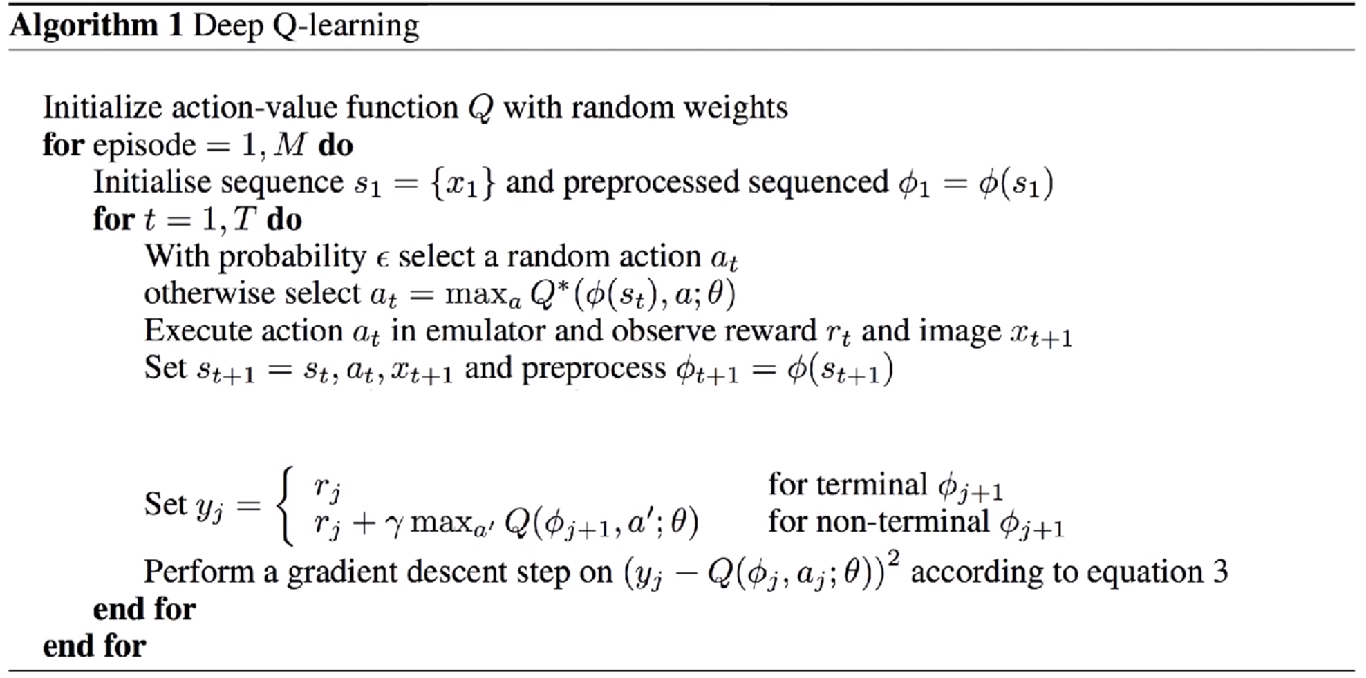
1
ATTENTION NETWORK in DEEP REINFORCEMENT LEARNING
Processing
States
Choi, Jinyoung, Beom-Jin Lee, and Byoung-Tak Zhang. "Multi-focus attention network for efficient deep reinforcement learning." Workshops at the Thirty-First AAAI Conference on Artificial Intelligence. 2017.

Slide 22
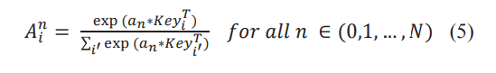
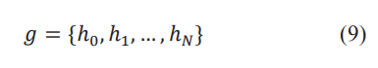
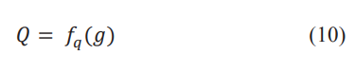
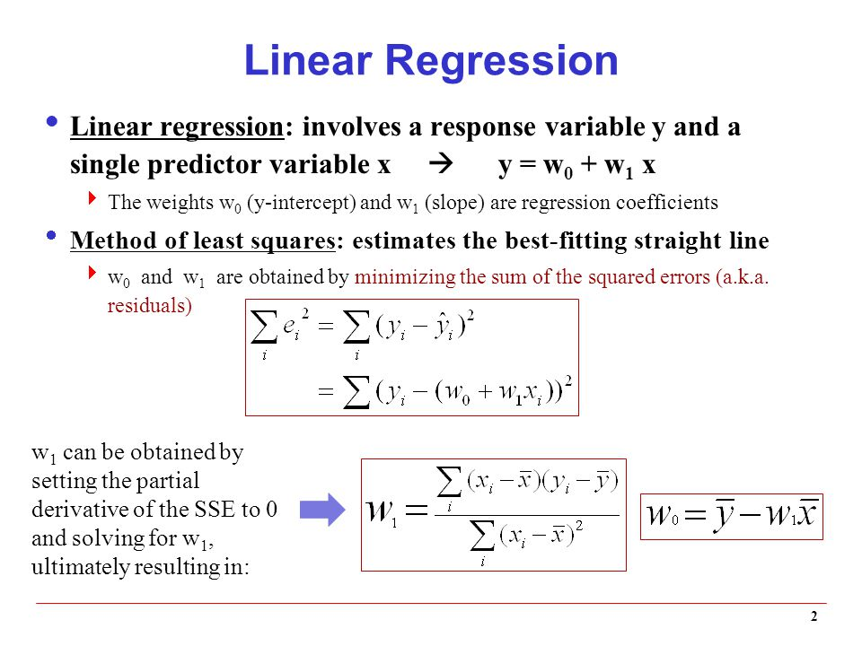
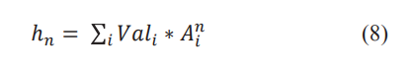
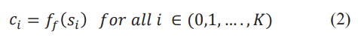
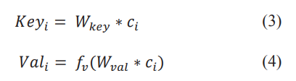
1
ATTENTION NETWORK in DEEP REINFORCEMENT LEARNING
Linear Regression Form
target
Pred

Slide 23
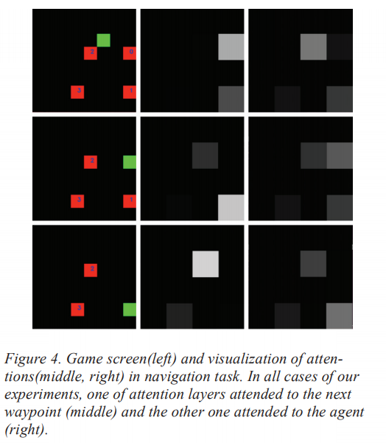
1
ATTENTION NETWORK in DEEP REINFORCEMENT LEARNING

